Slide 1
Développez des applications natives pour iOS, Android, Mac et Windows en C#
Julien Mialon
Xamarin Student Ambassador
mialon.julien@gmail.com
Notes:
Xamarin Introduction!

Slide 2
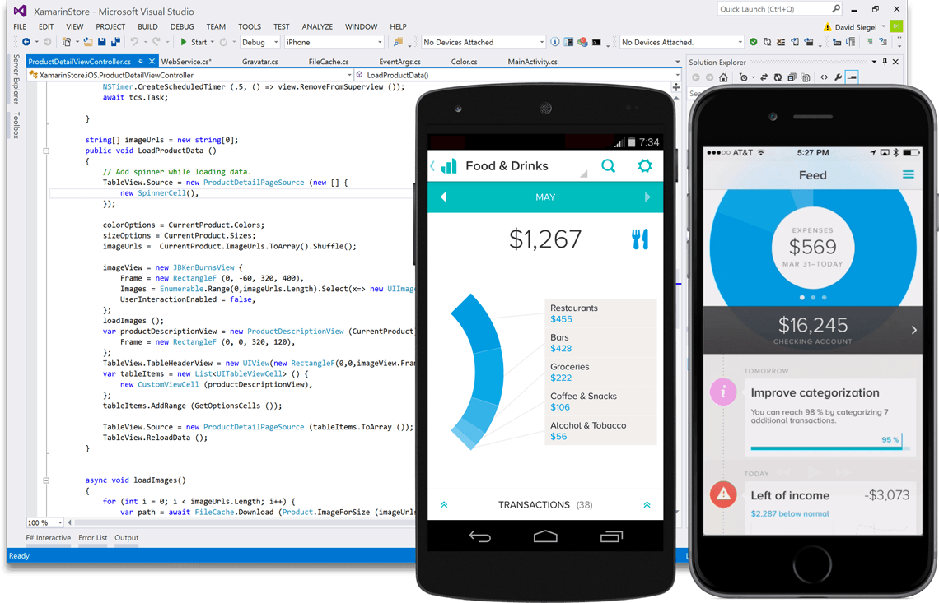
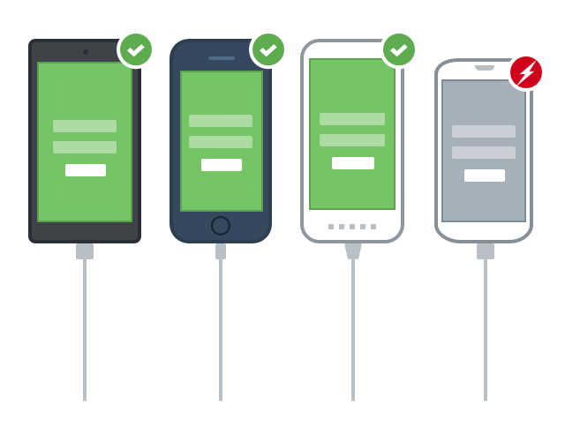

Xamarin est un moyen de
Créer
Tester
Monitorer

Slide 3
Différentes approches pour le Développement Mobile
Notes:
Let’s talk about the state of mobile development today

Slide 4
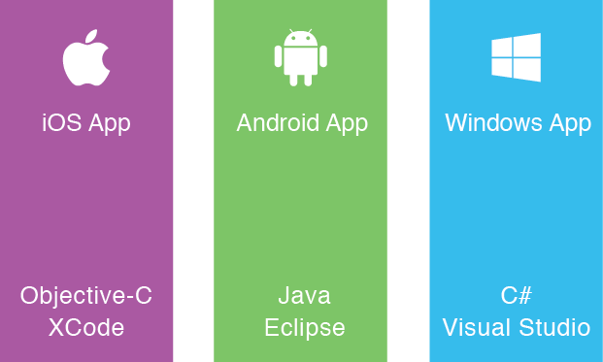
L’approche native
Créer l’application plusieurs fois
Plus de développeurs
Plus de maintenance
Différents environnements
Notes:
Multiple Teams
Multiple Code Bases
Expensive & Slow
Positive = Great apps delivered to user’s platform
Negative = Development hampered by multiple code bases & fragmentation

Slide 5
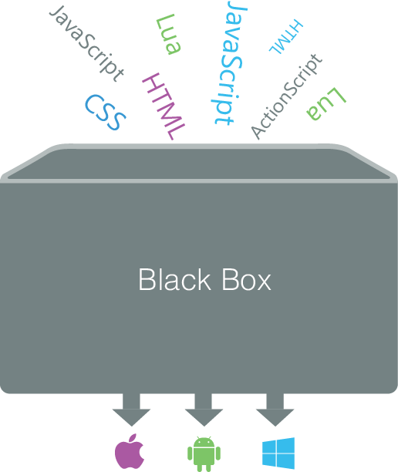
L’approche Write Once, Run Anywhere
Limitation au dénominateur commun
Fragmentation des web browsers
Développement & design pour 1 plateforme, fonctionne aussi sur les autres
Notes:
Unhappy Users
Unhappy Developers
Increase in Abandoned Apps
Limited to what is implemented

Slide 6
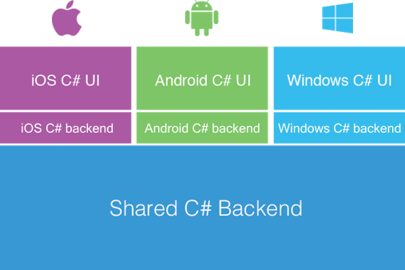
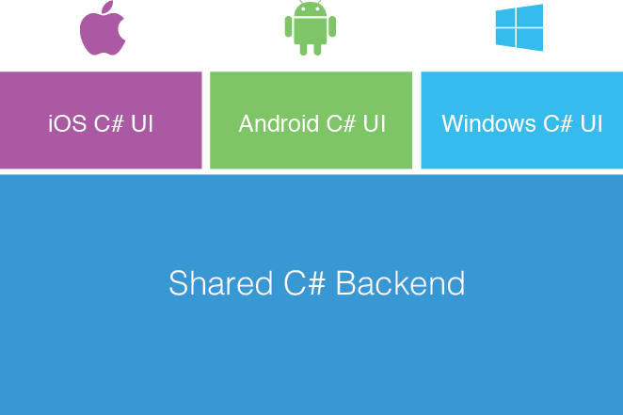
L’approche de Xamarin
UI native
Performance native
Code partagé
C# & .NET Framework
Accès à toutes les APIs de chaque plateforme
Notes:
UI build natively per platform, leveraging C#
C# + XAML
C# + XML
C# + XIB
One shared app logic code base, iOS, Android, Mac, Windows Phone, Windows Store, Windows

Slide 7
Pourquoi C# ?
Notes:
Let’s talk a bit about C# and why it is awesome.

Slide 8
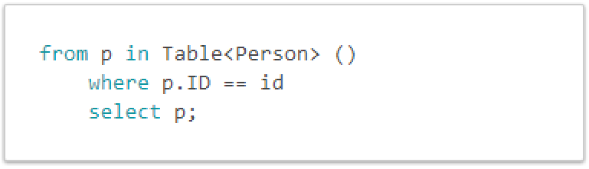
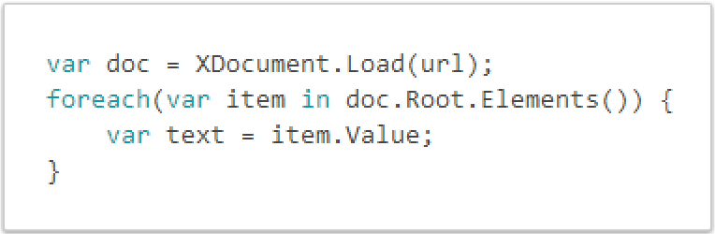
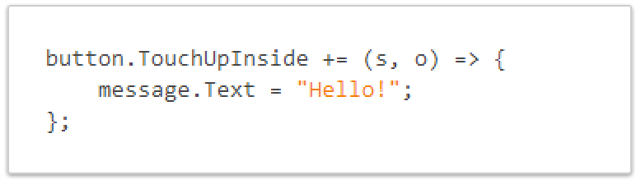
C# is Awesome
LINQ Support
XML support
Event Handling & Delegates
Notes:
Statically typed so you avoid a pitfall of errors that afflict other languages.
Use LINQ in your Xamarin projects to query, filter and select data from in-memory arrays, or from databases such as SQLite.
Parsing XML is easy
Setting up event handling is a breeze
Intellisense, lambdas, etc. are all awesome.

Slide 9
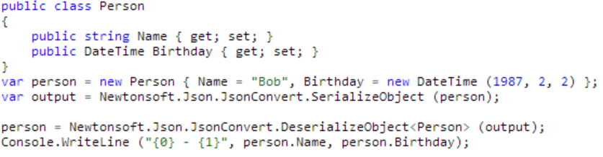
C# is Awesome - JSON
Json.NET permet de simplifier la conversion entre vos données JSON et vos objets .NET.
Notes:
Use your favorite libraries like Json.NET!

Slide 10
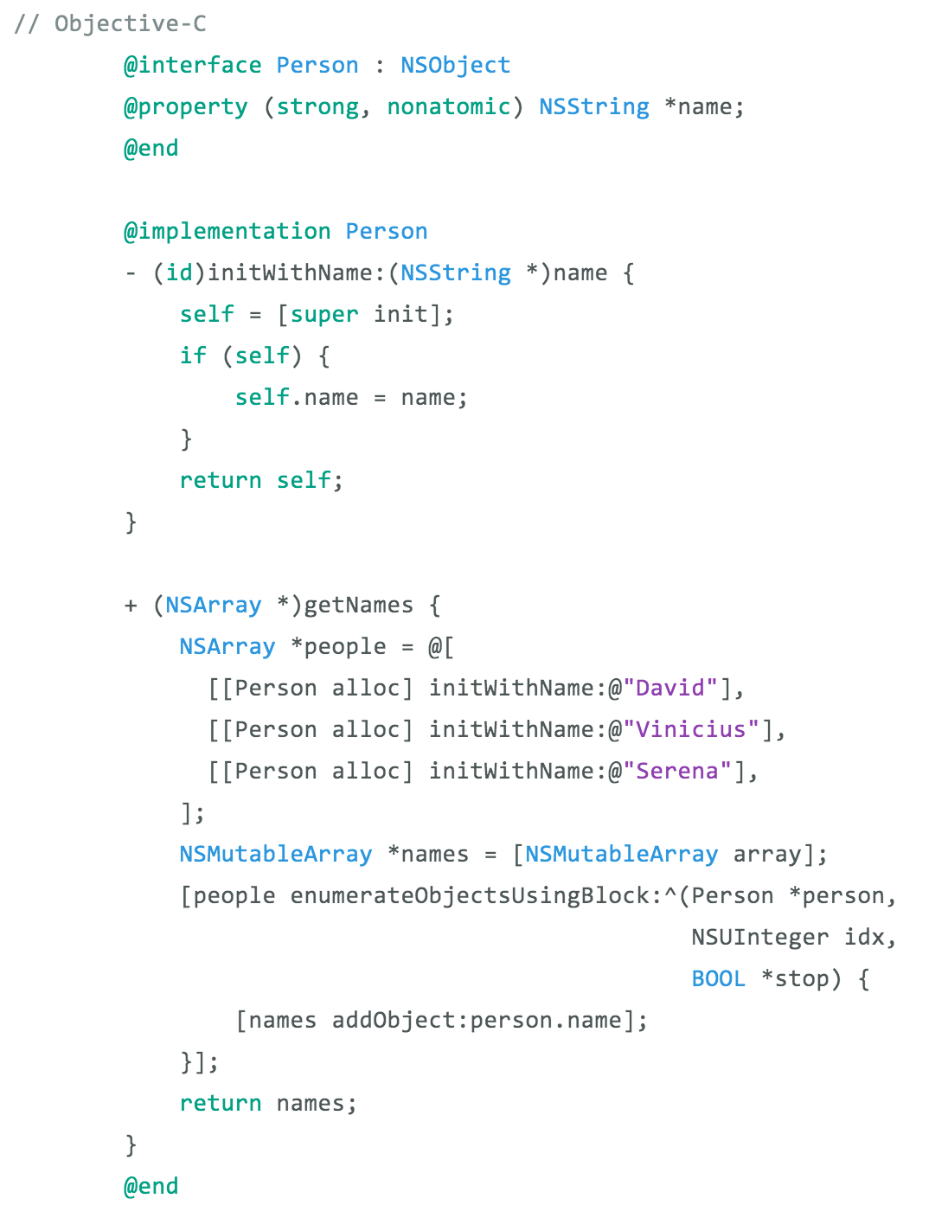
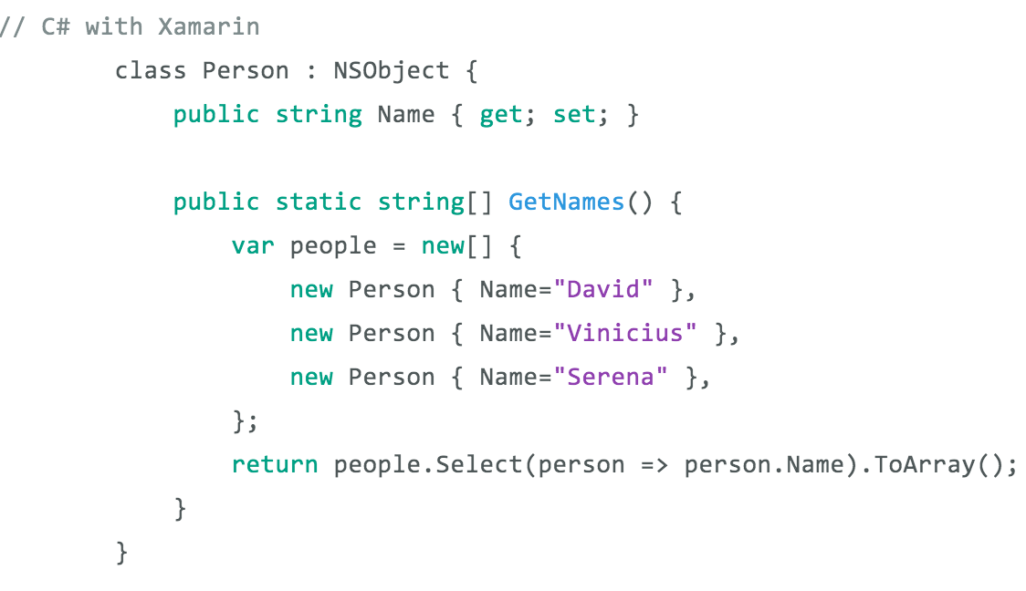
La différence – Classes et Méthodes
Objective-C
C# avec Xamarin
Notes:
Here is an example of creating a class with a method to get names
1 Line with LINQ to execute this command
Take advantage of C# features and set properties easily

Slide 11
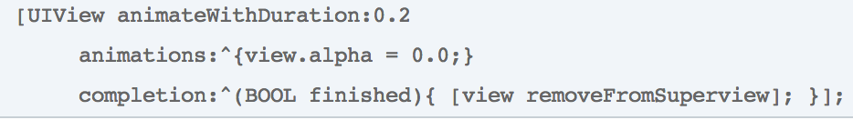
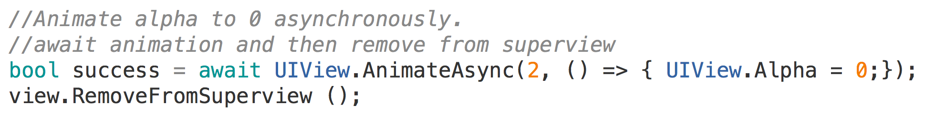
Simplification des API avec Async/Await
Objective-C
C# avec Xamarin
Notes:
With Xamarin we even extend native methods with C# Features
Here there is no need for a callback block, simply await on the animation to finish before continuing on

Slide 12
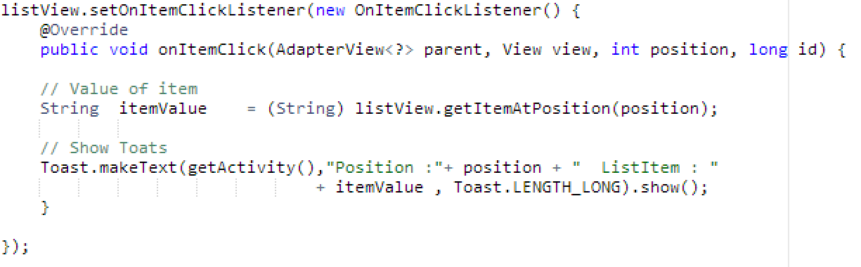
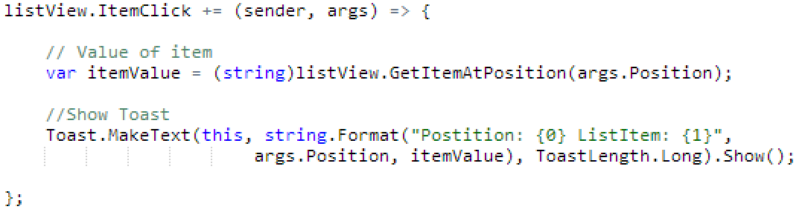
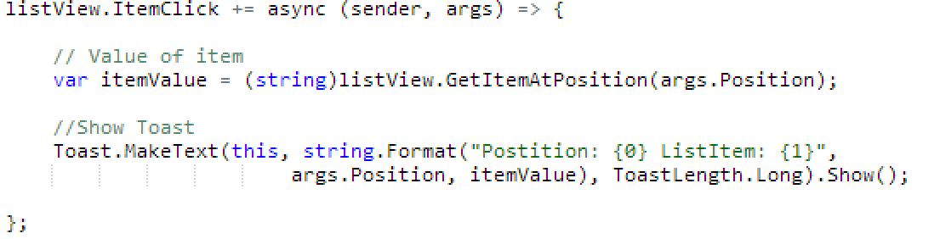
La différence – Android ItemClick
Java
C# avec Xamarin
C# & Async avec Xamarin
Notes:
Here we can see how easy it is just to do a += for an event and not have to implement a bunch of listeners every time. Easy to read, string.Format, using args, etc.
In fact we can make this call Async/Await by just adding async to the delegate!

Slide 13
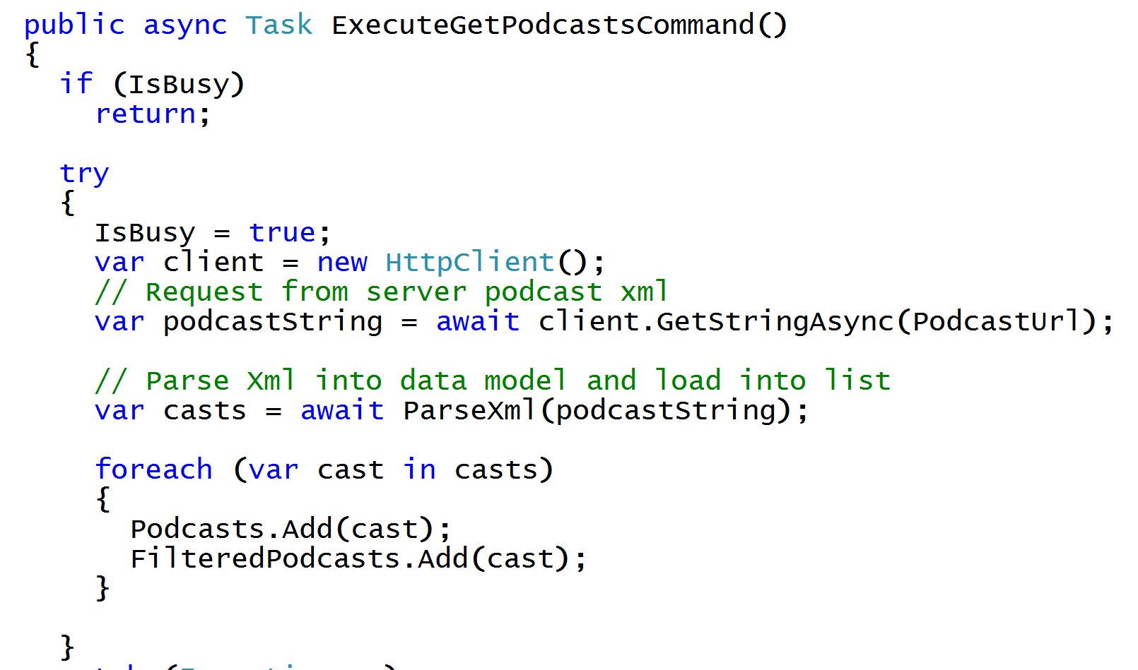
Async/Await
Écrivez du code simple & maintenable
Notes:
The async and await keywords in C# 5.0 now available to Xamarin developers make asynchronous programming incredibly pleasant.
You end up with code that is much more linear and much easier to understand.
The compiler does a lot of magic for you which simplifies your code and your life.

Slide 14
Comment
Xamarin
Fonctionne

Slide 15
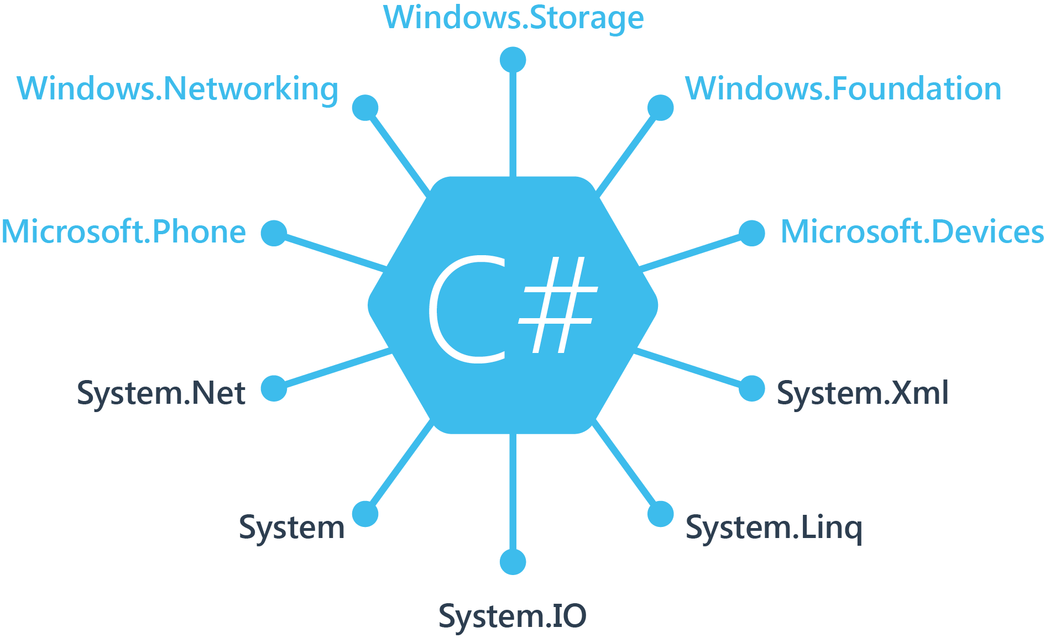
.NET + Windows APIs
Notes:
If you have ever developed for a Windows Platform before these .NET namespaces might look familiar.
However, if we go to a new platform such as Windows Phone or Store we have a new SDK to use and a new set of namespaces.

Slide 16
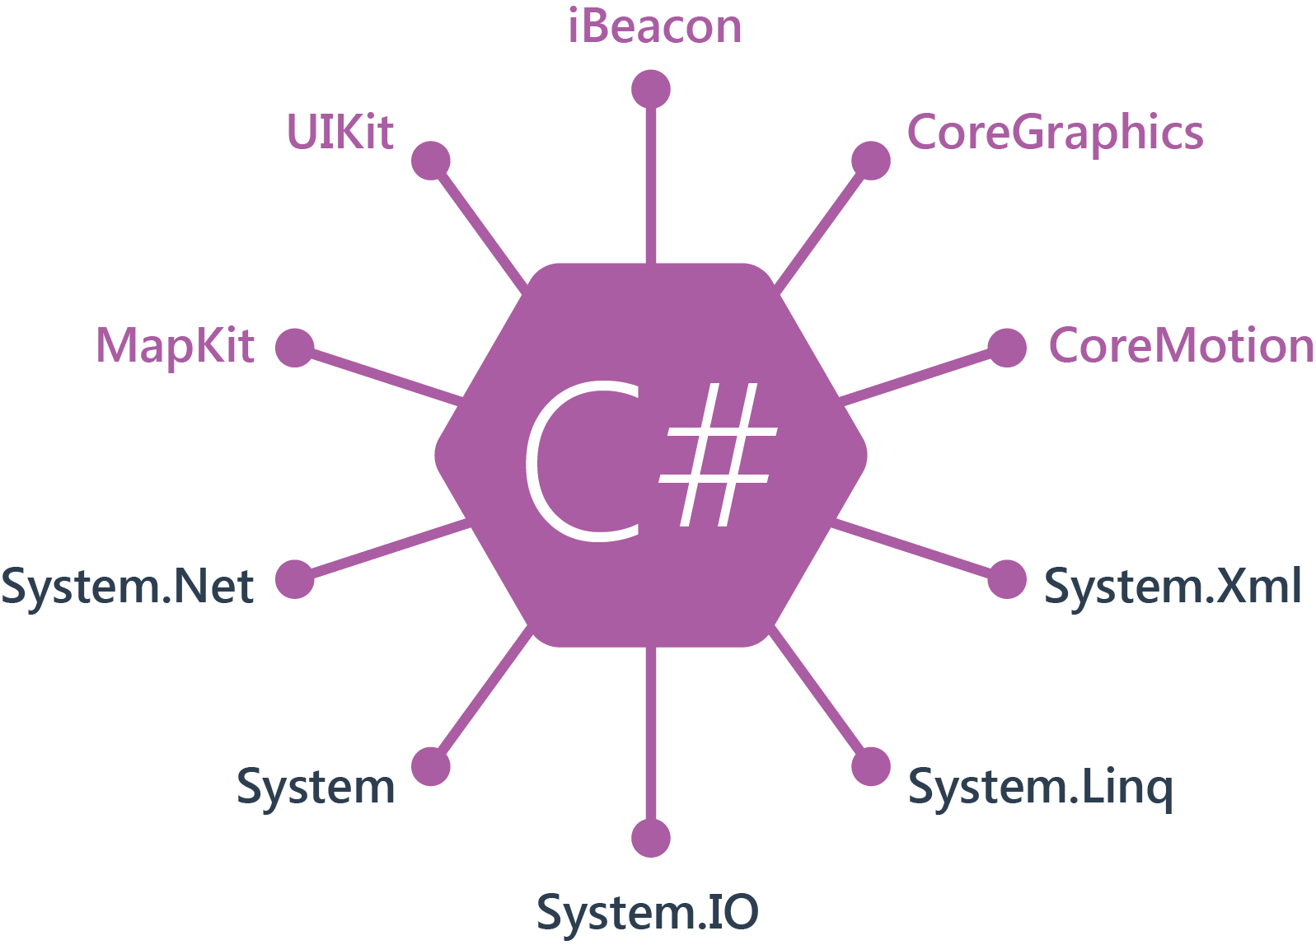
.NET + iOS APIs | 100% Coverage
Notes:
You can think of iOS and Android development the same with Xamarin. You can see we have all of our .NET namespaces and libraries, but Xamarin give us 100% api coverage of each iOS API in it’s SDK that we access view C#.

Slide 17
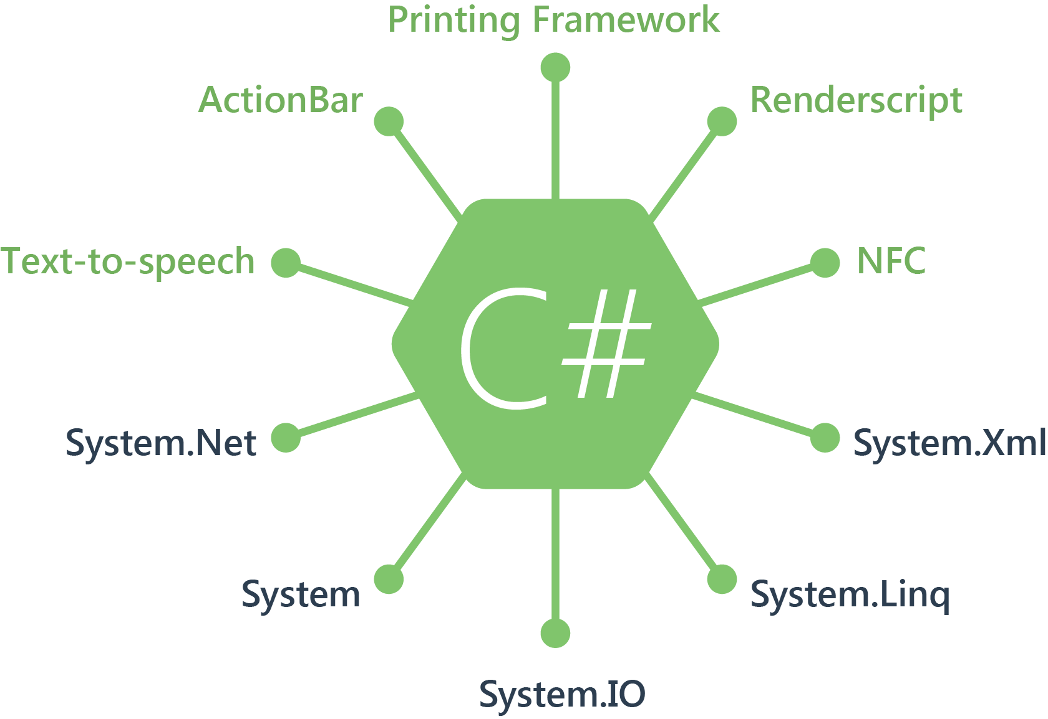
.NET Android APIs | 100% Coverage
Notes:
The same is true for Android as well.

Slide 18
Tout ce que vous pouvez faire en Objective-C, Swift ou Java peut être fait en C# avec Xamarin et Visual Studio.

Slide 19
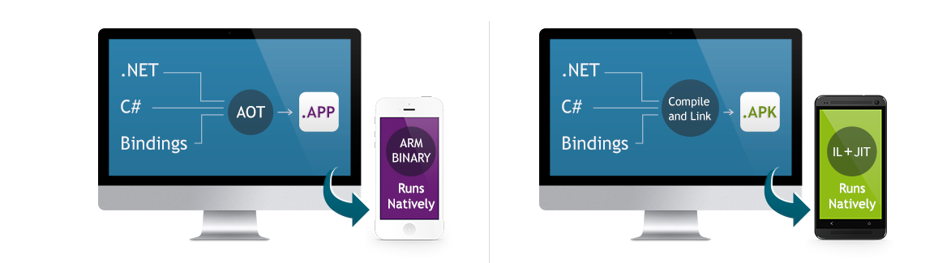
Performance native
Xamarin.iOS compile votre application en binaire ARM pour l’App Store d’Apple.
Xamarin.Android utilise un système Just In Time lors de l’exécution.
Notes:
There is no compromise on performance.
Xamarin apps look and feel native because they are native.

Slide 20

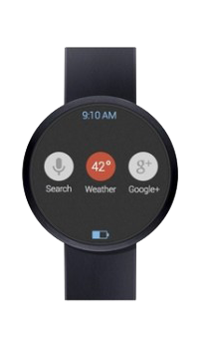
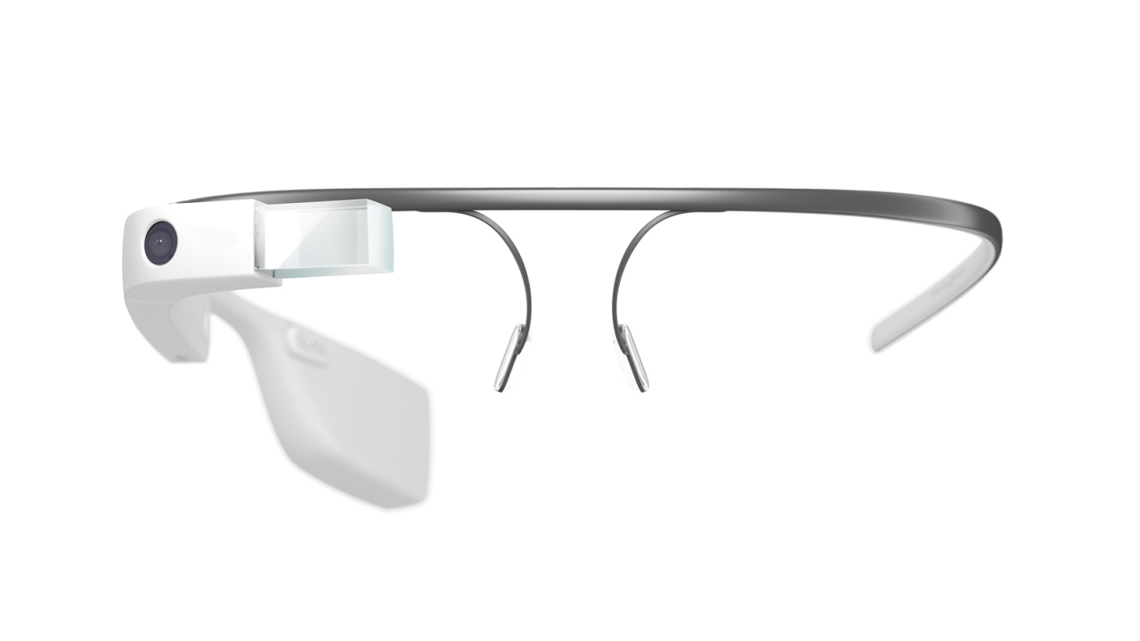
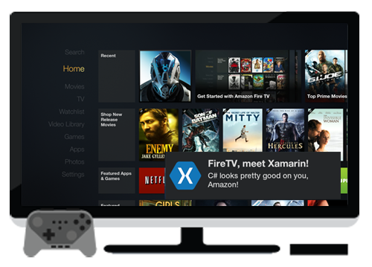
Toujours à jour
Support le jour de la sortie :
iOS 5, iOS 6, iOS 7, iOS 7.1, iOS 8
Support complet :
Google Glass
Android Wear
Amazon Fire TV
Et plus !
Notes:
Apple has a developer preview where Xamarin has alphas ready. Google does not offer this.
Android versions are usually 4 to 8 weeks out for a stable release, but alphas and betas are usually earlier.
Xamarin realizes how important having iOS ready because within 24 hours a large portion of iOS users upgrade
Android on the other hand is much different. After 4 months on the market Android 4.4 only had 1% adoption

Slide 21

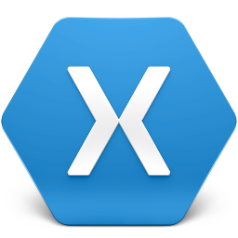
Environnement de développement
Xamarin Studio
PC ou Mac
Visual Studio Plugin
VS 2010 et Plus
Notes:
Xamarin Studio
PC -> Android
Mac -> iOS, Android, Mac
Visual Studio: iOS, Android Windows

Slide 22
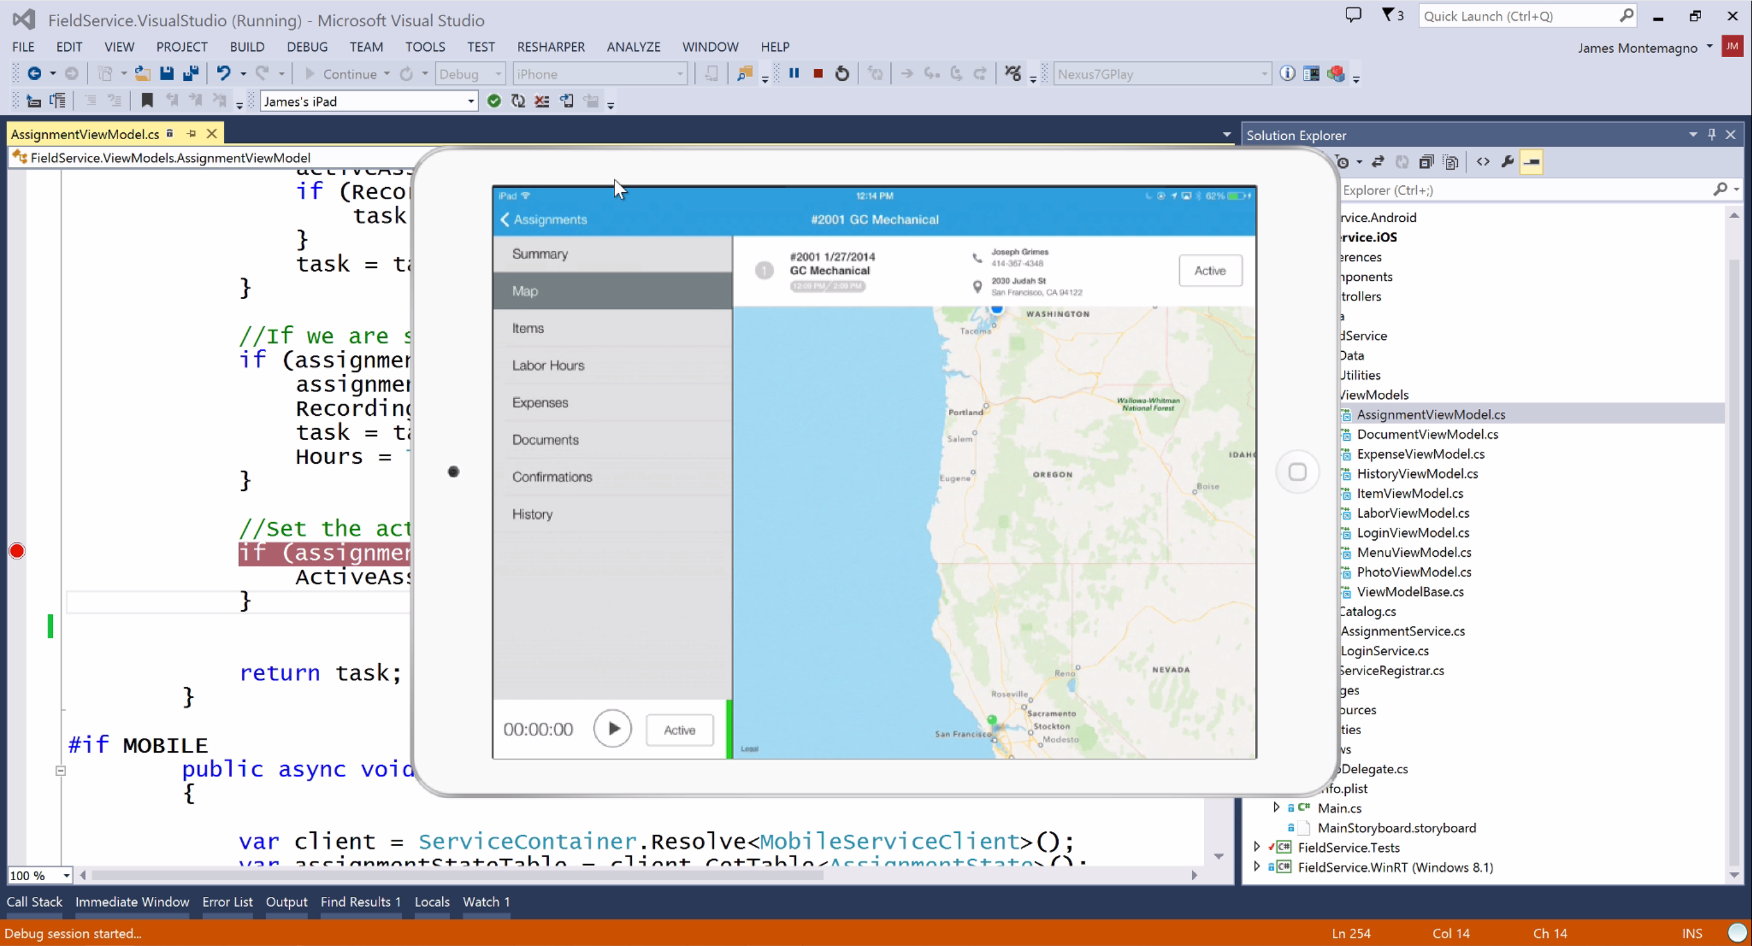



Intégration dans Visual Studio
Une seule solution :
iOS
Android
Windows Phone
Windows Store
Utilisez l’écosystème Microsoft :
ReSharper
Team Foundation Server
Tous vos outils préférés
Notes:
Additionally Supports Visual Studio 2010, 2012, & of course 2013
Additionally support desktop apps on Windows: WPF, ASP.NET, Silverlight, WinForms!
The same Solution & Projects open in BOTH Xamarin Studio and Visual Studio!

Slide 23
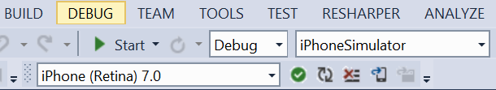
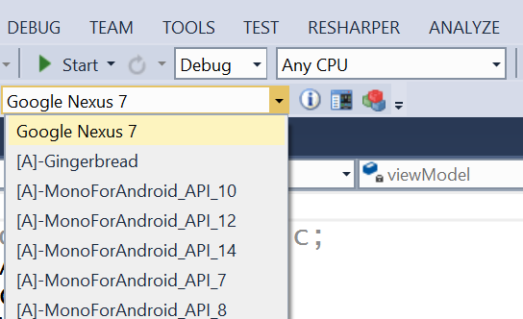
Intégration dans Visual Studio
Déboguez sur :
Émulateurs
Devices
Notes:
Connect to Mac build host for iOS development
Show list of all iOS devices and Simulators to debug on
Shows all Android devices and emulators
X86, Arm, Genymotion..
Take advantage of all debugging power of VS

Slide 24
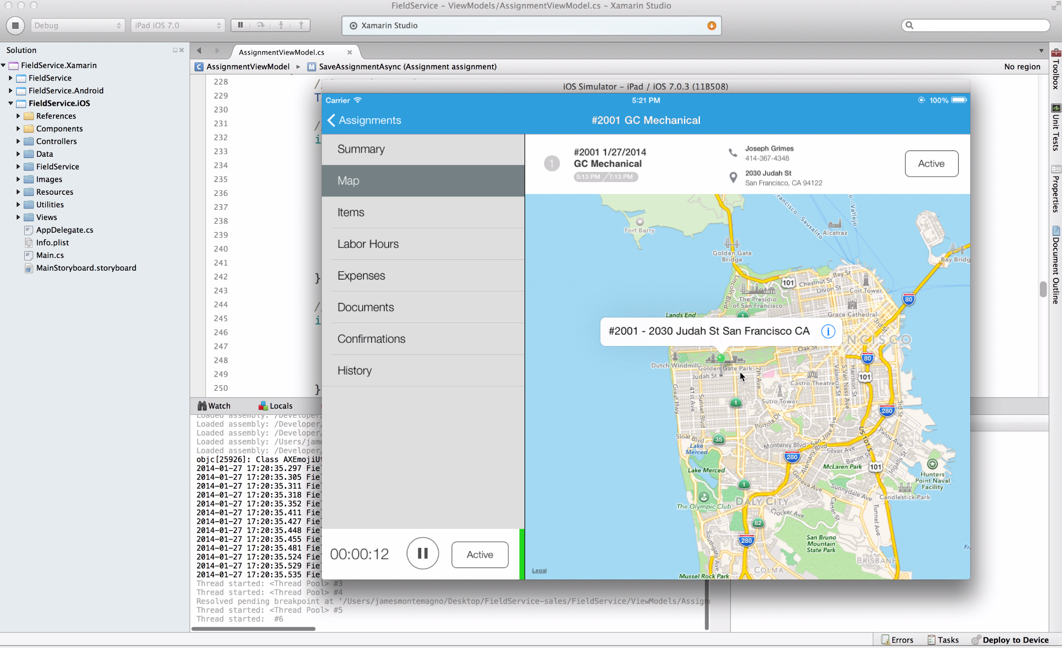
Xamarin Studio
Optimisé pour le développement mobile cross-platform
Explorez les APIs avec l’auto complétion
Designers pour Android et iOS
Débogage puissant sur émulateur ou device
Notes:
Xamarin Studio is available for Android development on the PC.
Xamarin Studio on Mac offers: Android, iOS and Mac development
World Class IDE with great features:
Code Analysis
Upload to Test Flight
Git & Subversion Integration
Code Completion
Code Navigation
Easy transition from Visual Studio
The same Solution & Projects open in BOTH Xamarin Studio and Visual Studio!

Slide 25
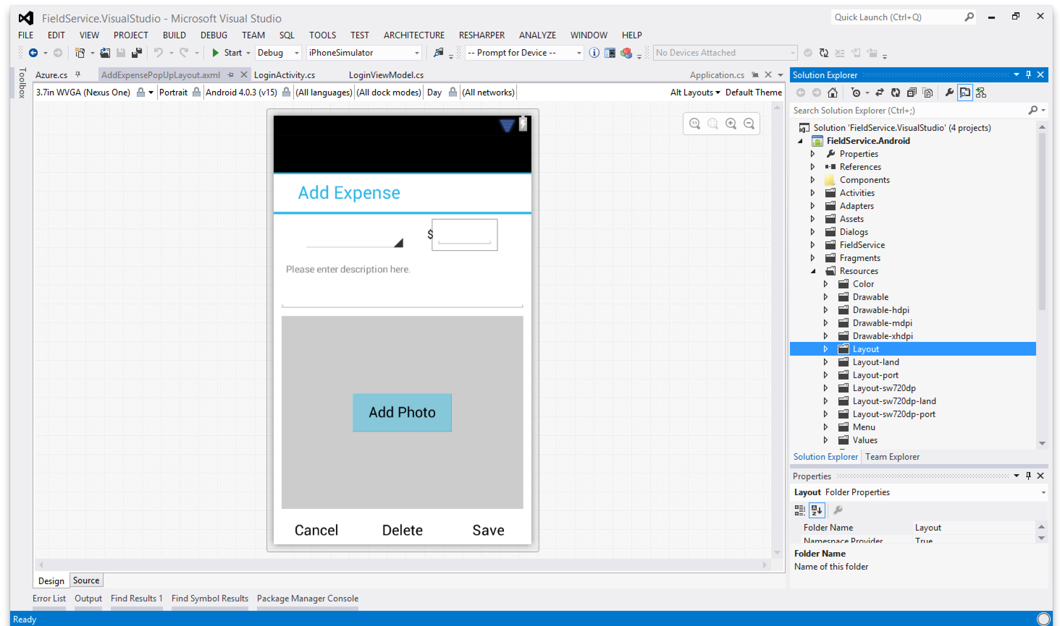
Designer Android
Disponible dans :
Xamarin Studio
Visual Studio
Créez votre UI avec un simple drag & drop
Ciblez des écrans, des résolutions et des versions d’Android différentes
Les layouts sont au format XML standard d’Android
Notes:
State of the art features:
View different Themes
View different device sizes
Multi-view editing!

Slide 26
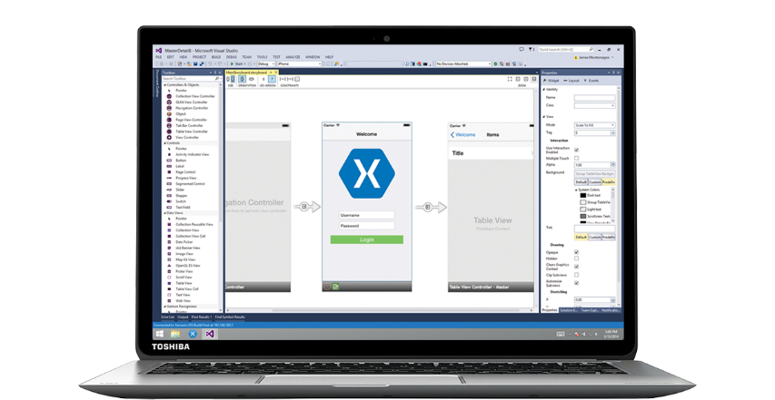
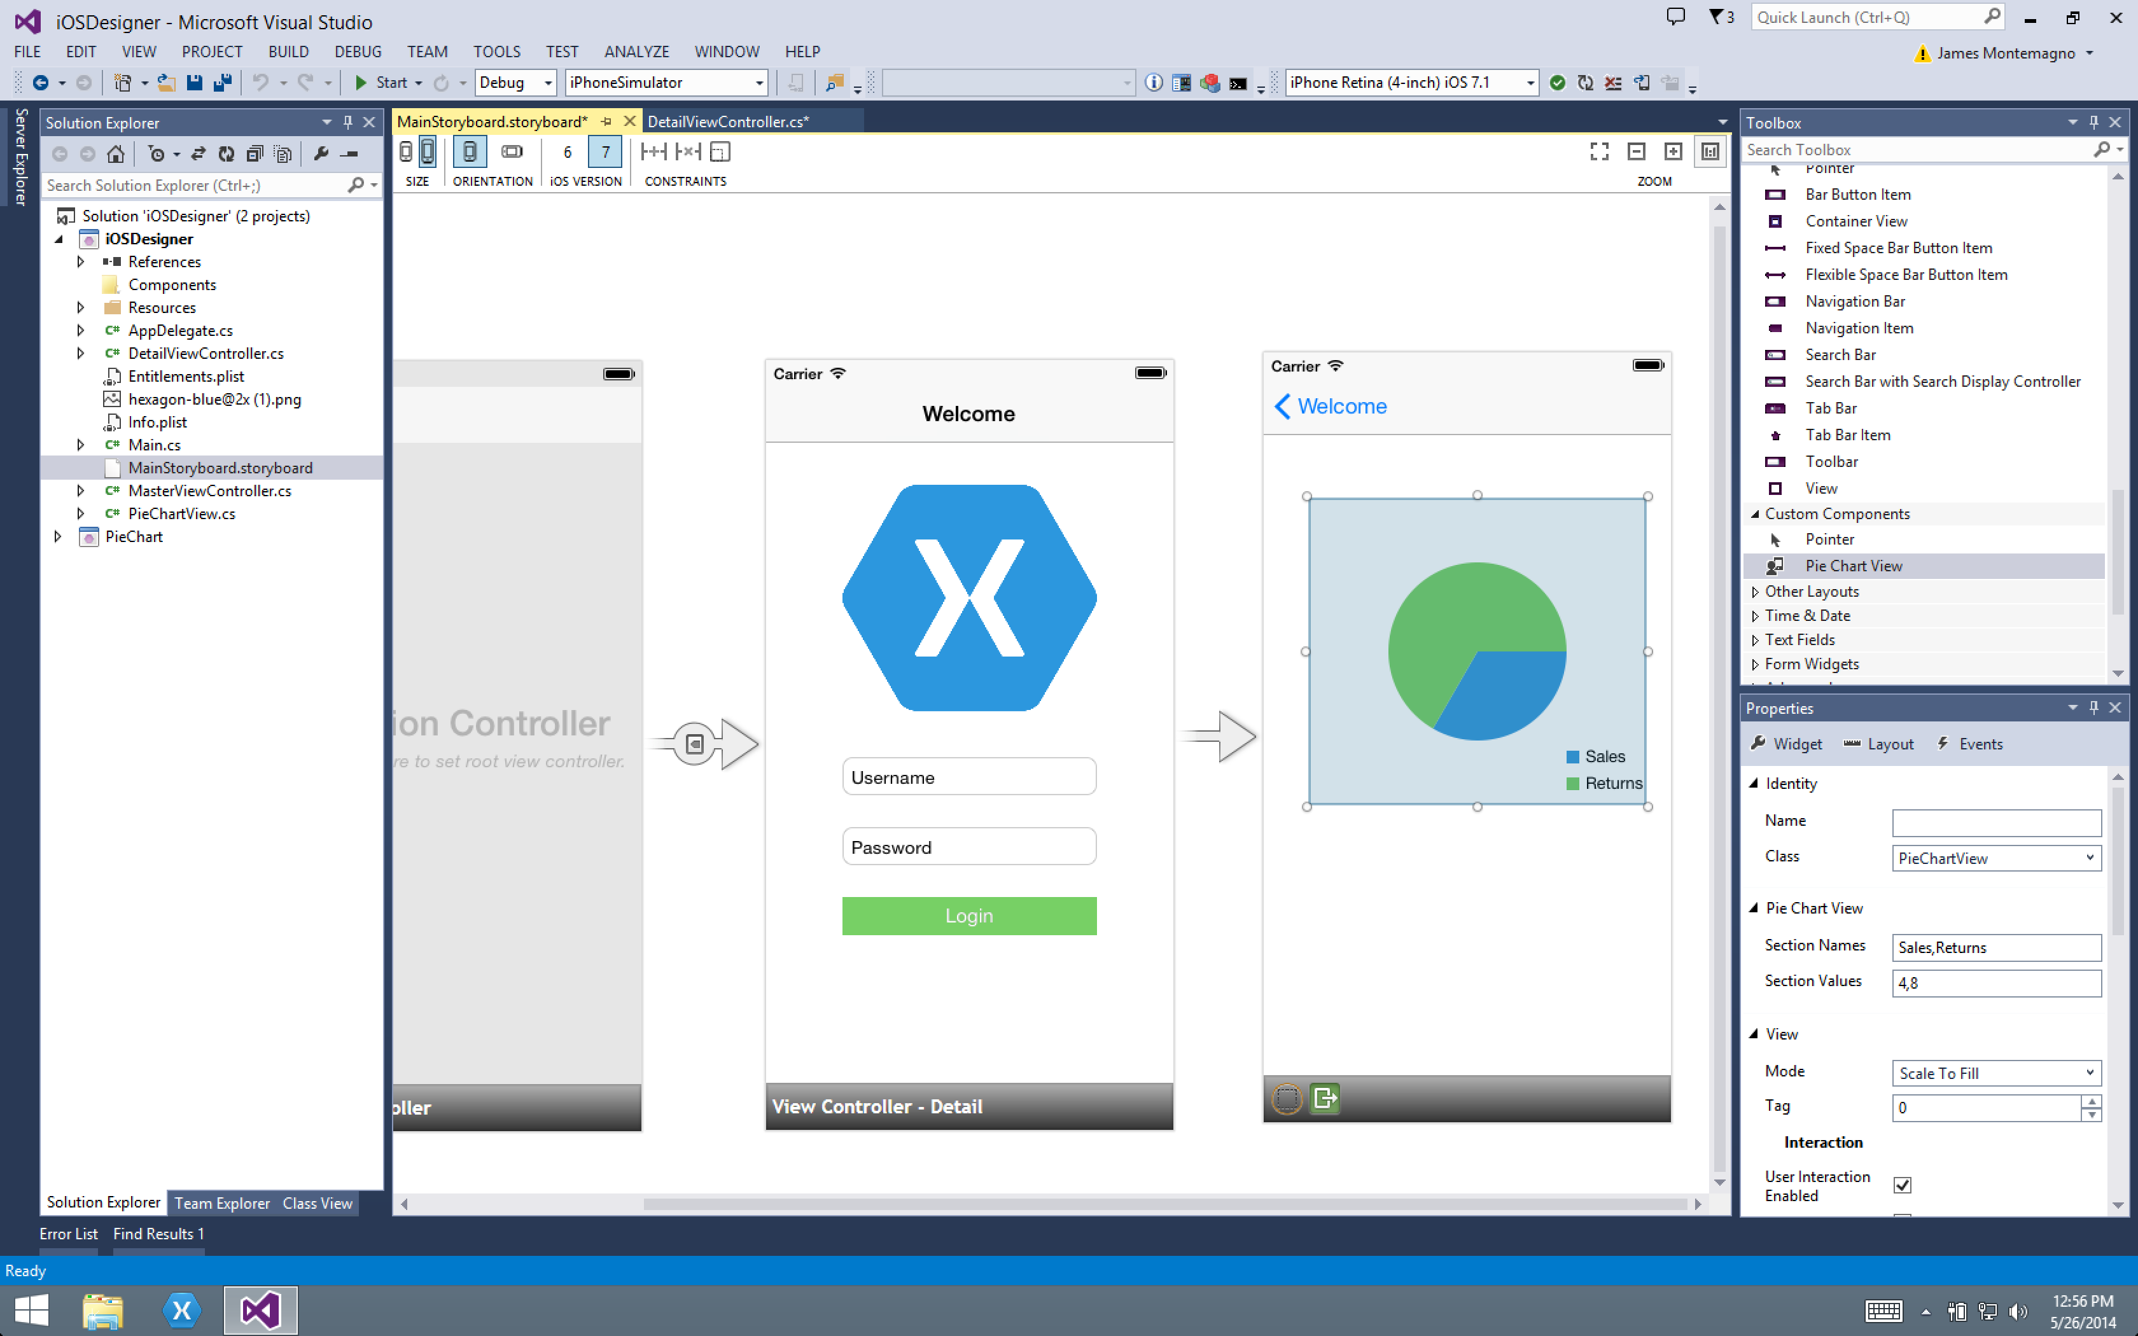
Xamarin Designer pour iOS
Disponible dans Xamarin Studio et Visual Studio
Support de tous les éléments UIKit
Support de composants tiers
Aperçu des changements en temps réel
Notes:
Attention : la video démarre toute seule !!!

Slide 27
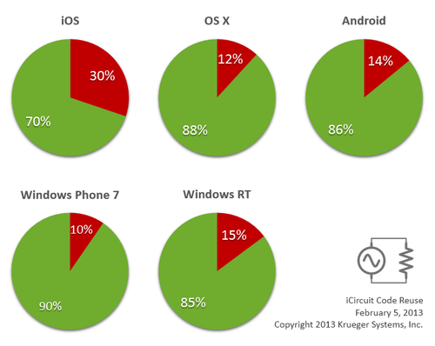
Partage de code : Accélérer le développement
Source: http://praeclarum.org/post/42378027611/icircuit-code-reuse-part-cinq
Notes:
iCircuit is made by Frank Krueger, a long time Mono & Xamarin developer.
Sharing code lead to 70 to 90% code reuse across platforms speeding up development
Real-time circuit simulator and editor used to design analog and digital circuits
http://praeclarum.org/post/42378027611/icircuit-code-reuse-part-cinq

Slide 28
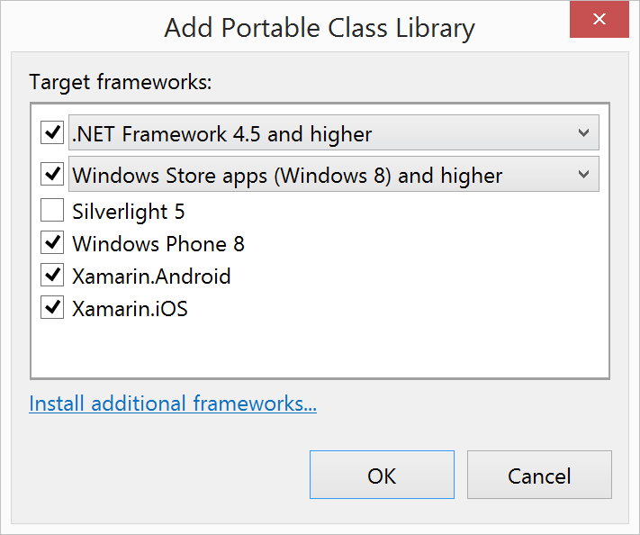
Portable Class Libraries
1 Assembly
Plusieurs plateformes
Incluant :
Xamarin.Android
Xamarin.iOS
Notes:
Portable Class Libraries are awesome!
You can write all of your C# code in one assembly and share across all platforms
Before the Xamarin & Microsoft Partnership PCLs were limited ONLY to Windows Platforms
Now add official support to create and use PCLs in Visual Studio and Xamarin Studio

Slide 29
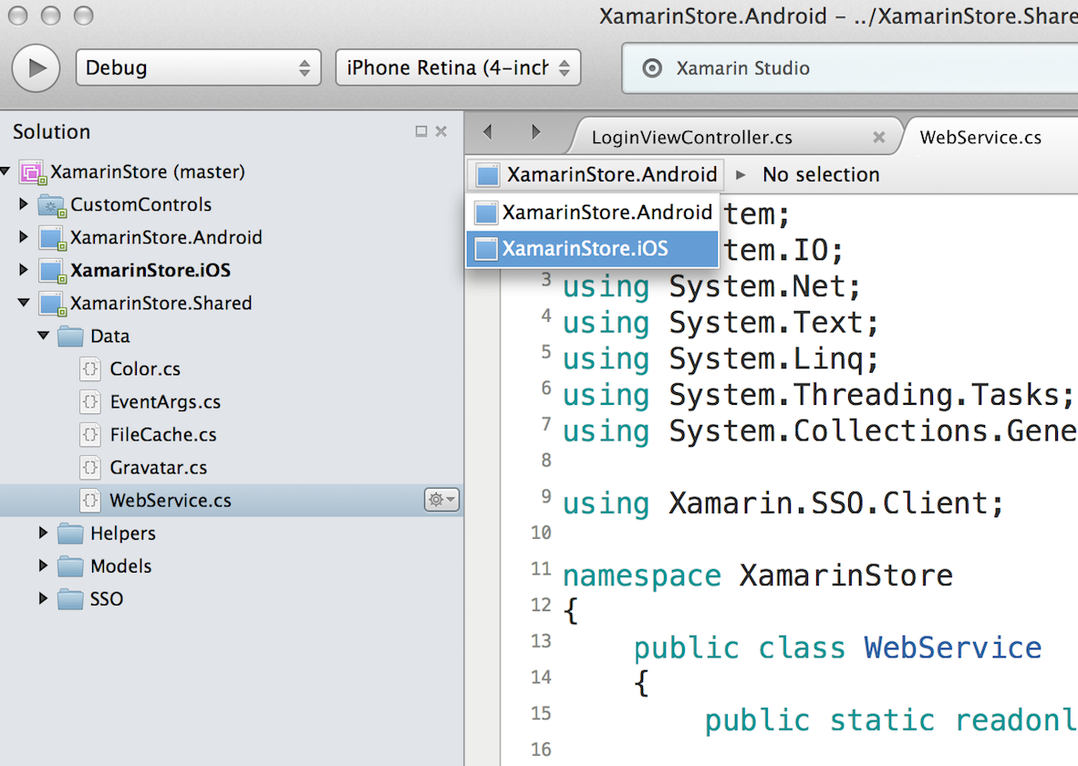
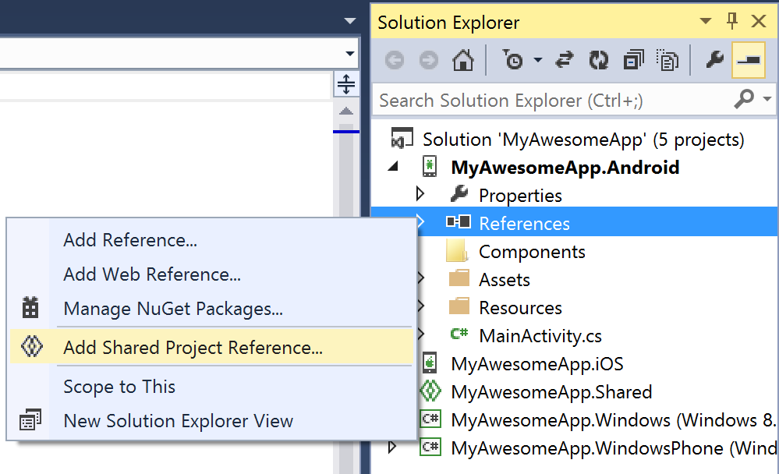
Shared Projects

Slide 30
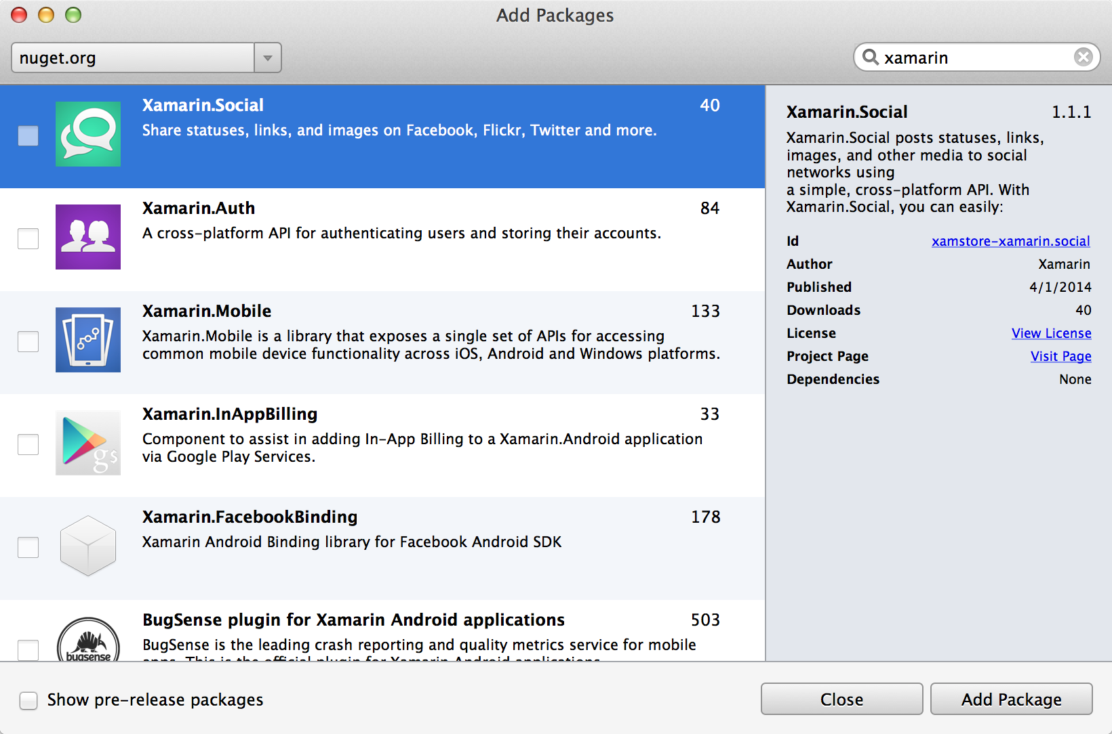
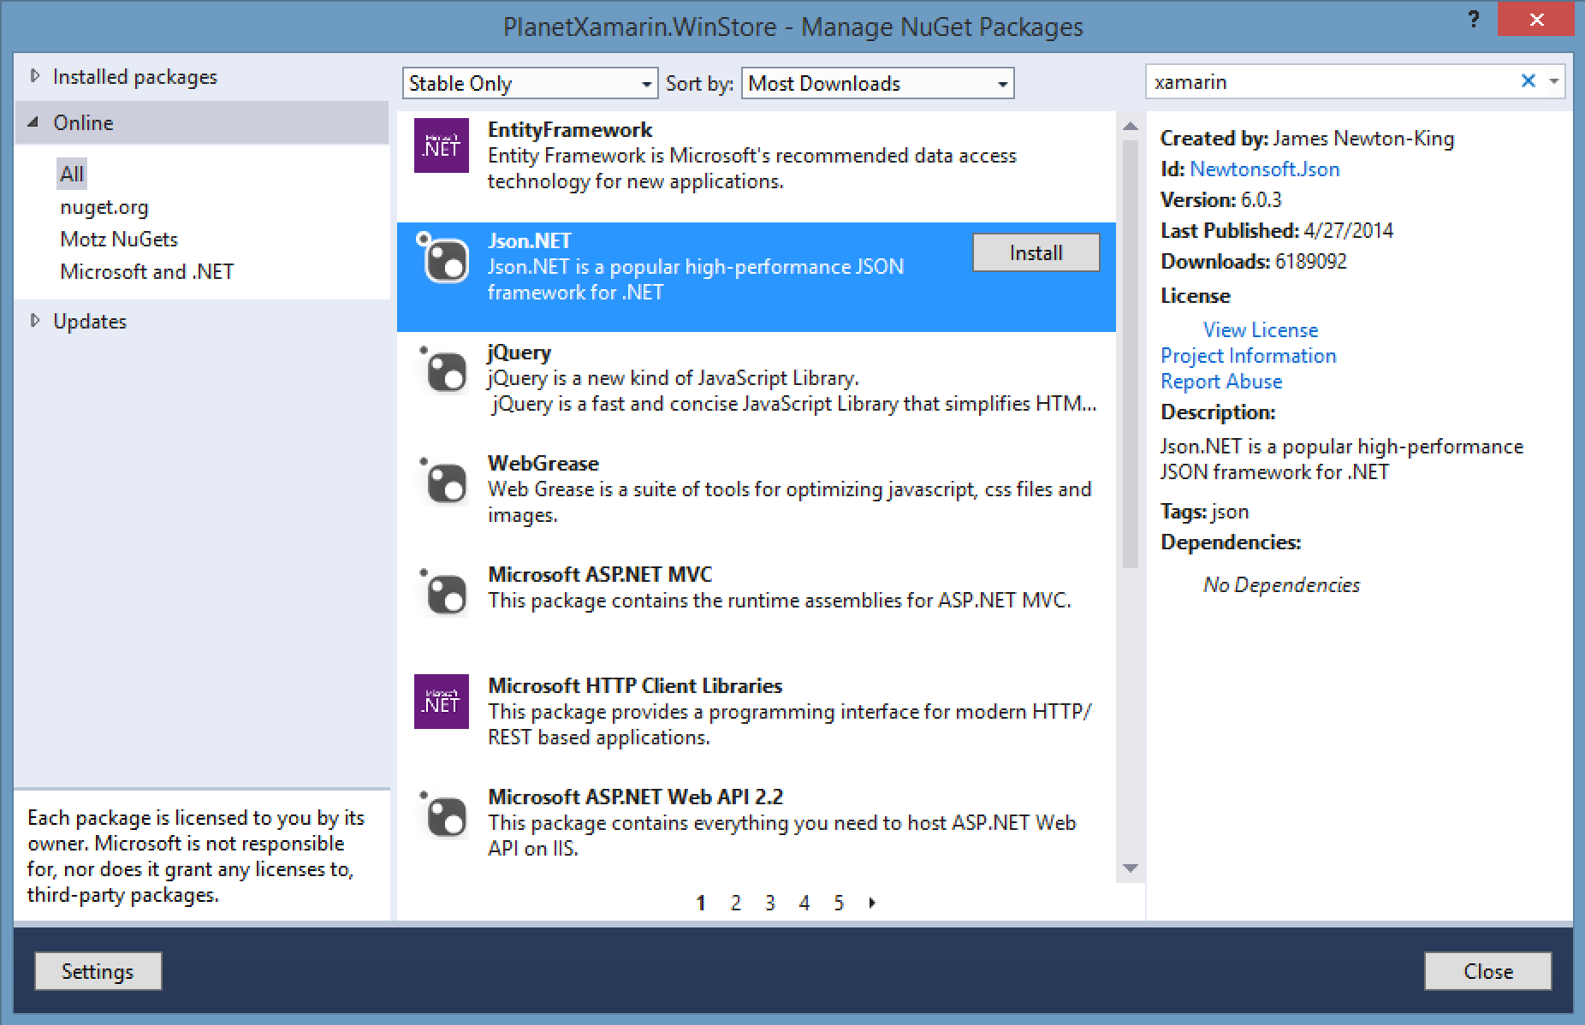
NuGet

Slide 31
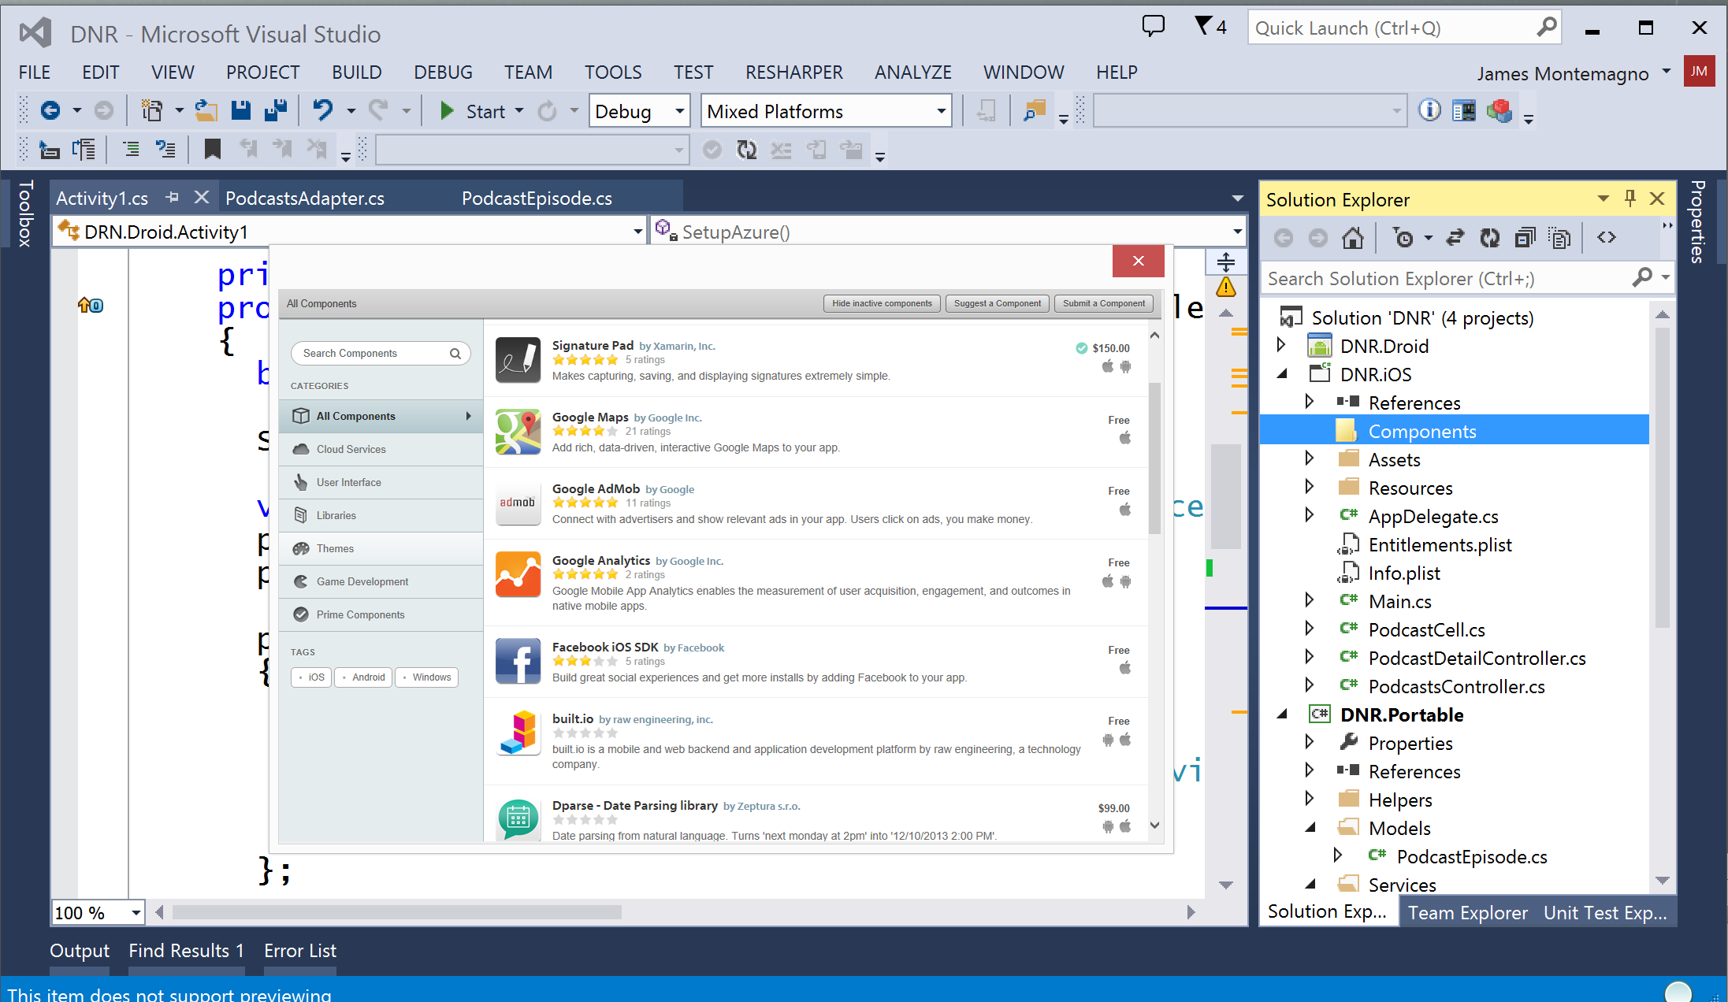
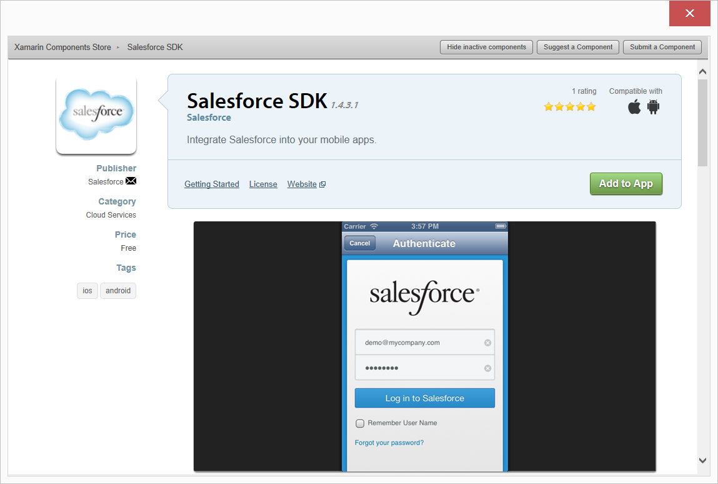
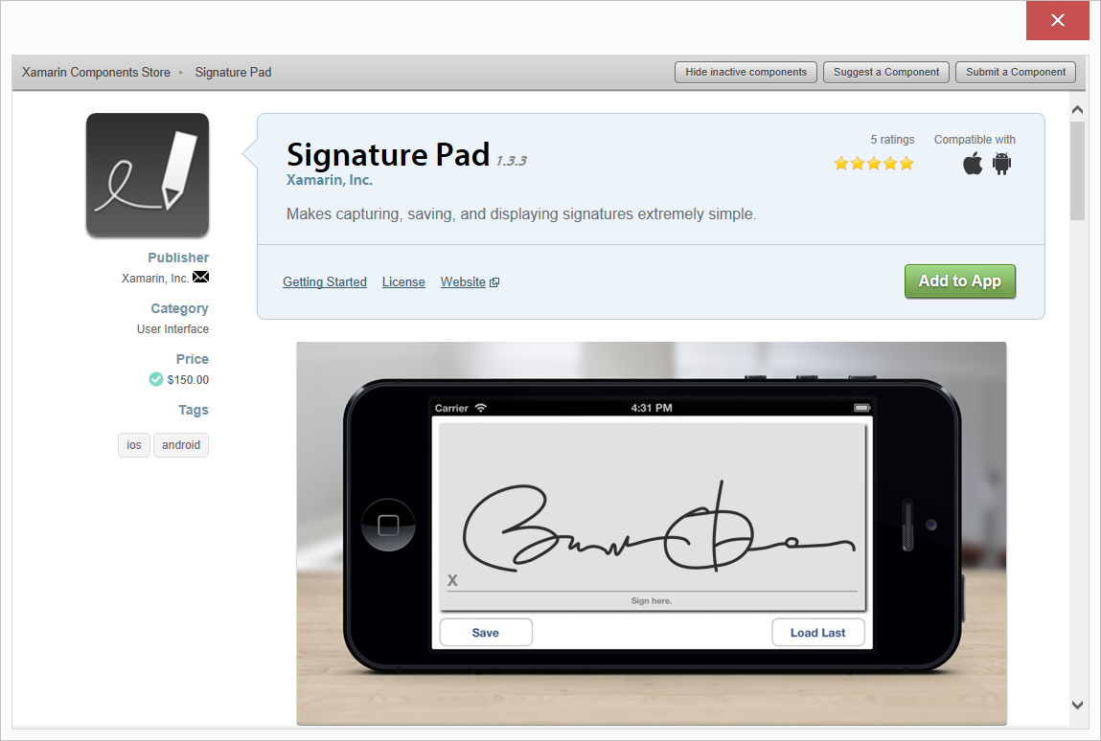
Xamarin Component Store
Créez plus vite
Ajoutez des composants existants depuis Visual Studio ou Xamarin Studio
Des éléments d’UI, d’intégration avec un service cloud et d’autres sont disponibles
Notes:
Add high quality pre-built app components directly from Visual Studio.
Includes dozens of beautiful UI controls and web services – adding a theme or a 3rd party library is just a few clicks away
Complements existing .NET NuGet ecosystem
Differentiator: focus on UI controls and themes – we are making developers better designers across all platforms

Slide 32






Distribuable partout
Une application Xamarin peut être distribuée partout
Notes:
Compiles down to APK or IPA that you can distribute anywhere, any store.
Or even internal enterprise

Slide 33
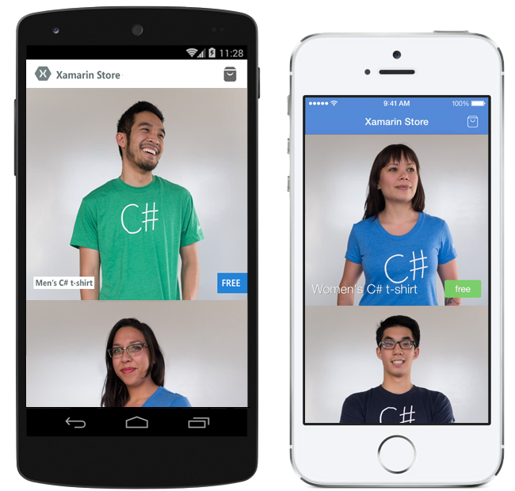
Pre-built T-Shirt Store
Features:
Shopping Cart
Social Share
Gravatar Integration
Beautiful Animations
Technical Details
Code sharing with Shared Project
Android Fragments
Local image caching
Cross platform image downloading
Modular/self-contained screens
http://xamarin.com/prebuilt/sharp-shirt
Notes:
Open source apps, you can download and get started with today

Slide 34

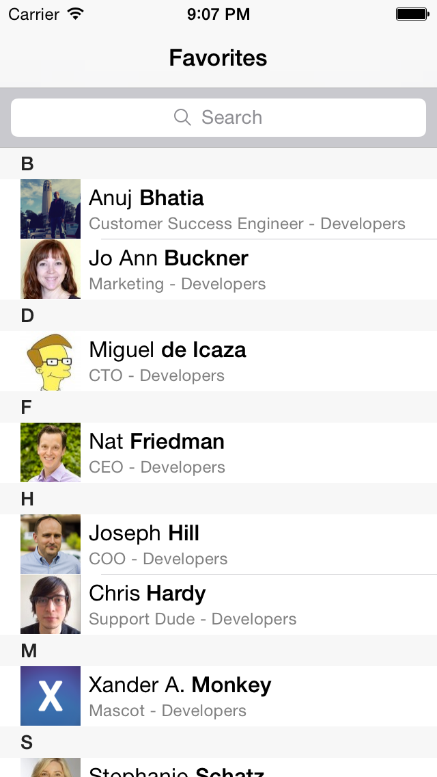
Pre-built Employee Directory
Features:
LDAP-ready for easy integration into your corporate directory
Multiple search options
Ability to favorite contacts
Ability to call or email from contact’s listing
Gravatar Integration
Technical Details
iPhone, Android, and Windows native user interfaces
Uses MVVM, shared view-models across platforms
SQLite data store with a .NET-based SQLite ORM on all platforms
Ability to hook up your enterprise backend
http://xamarin.com/prebuilt/employee-directory
Notes:
Open source apps, you can download and get started with today

Slide 35
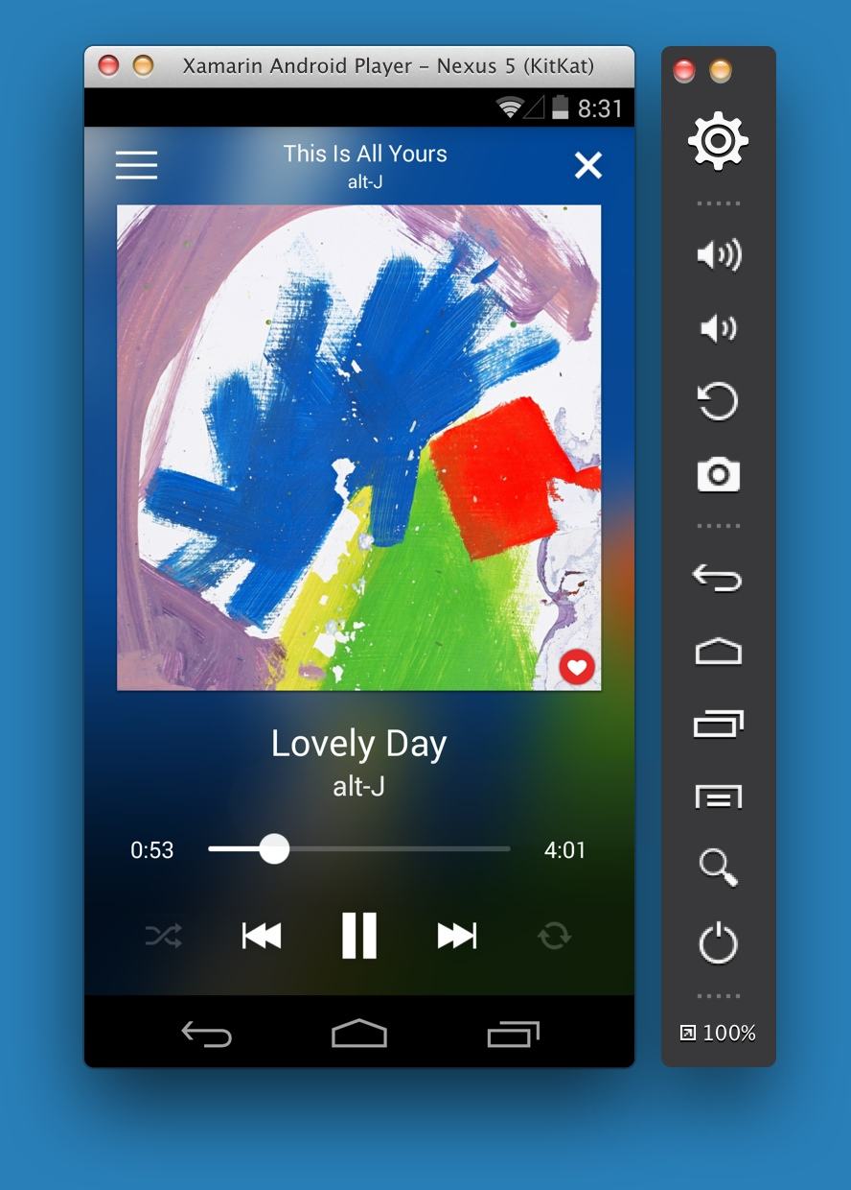

Xamarin Android Player
High Speed Android Emulator
Mac ou PC
Xamarin.com/Android-Player
Notes:
Xamarin Android Player runs on Mac or PC and is built natively on each platform with Xamarin.Mac and WPF.
On PC you will have no issues running the Xamarin Android Player if Hyper-V is enabled as you can run it side-by-side with no issues.

Slide 36
Démo
#OrleansTechTalks
Notes:
Demo time if so desired

Slide 37
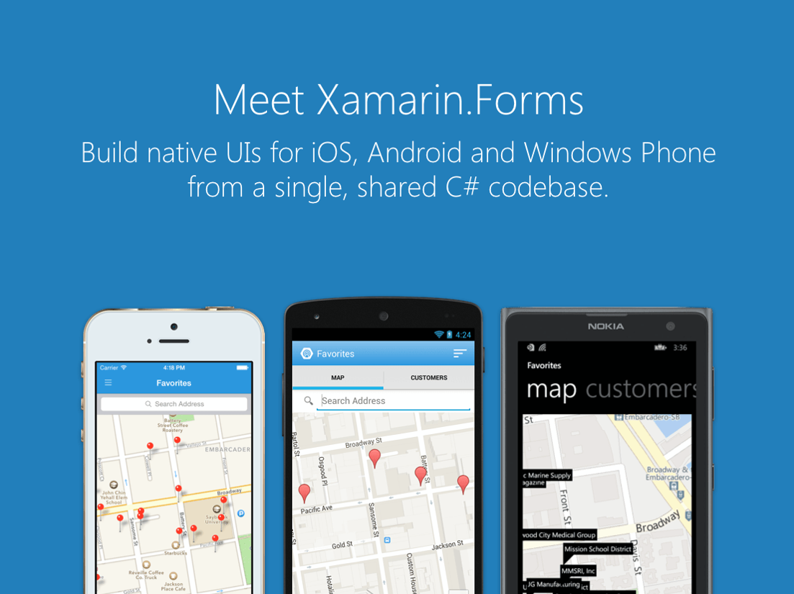
Notes:
Xamarin Forms is a new set of APIs allowing you to quickly and easily write shared User Interface code that is still rendered natively on each platform, while still providing direct access to the underlying SDKs if you need it.

Slide 38
L’approche de Xamarin.Forms
Xamarin
Xamarin.Forms:
Plus de code partagé, UI native
Shared UI Code
Notes:
Xamarin recently introduced Xamarin.Forms a new library for cross platform user interface. We will touch up on this later, but this enables you to be highly productive, share code, but build out UI on each platform and access platform APIs.
With Xamarin.Forms you now have a nice Shared UI Code layer, but still access to platform APIs
You can start from native, pick a few screens, or start with forms, and replace with native later

Slide 39
De quoi dispose-t-on ?
+40 Pages, Layouts, et Controls
Utilisable en C# ou Xaml
Two-way Data Binding
Navigation
Animation API
Dependency Service
Messaging Center
Shared UI Code
Notes:
Xamarin.Forms is much more that just a framework and includes everything you need to get up and running to build out full native applications.
If you are used to MVVM type of development you will feel right at home.

Slide 40
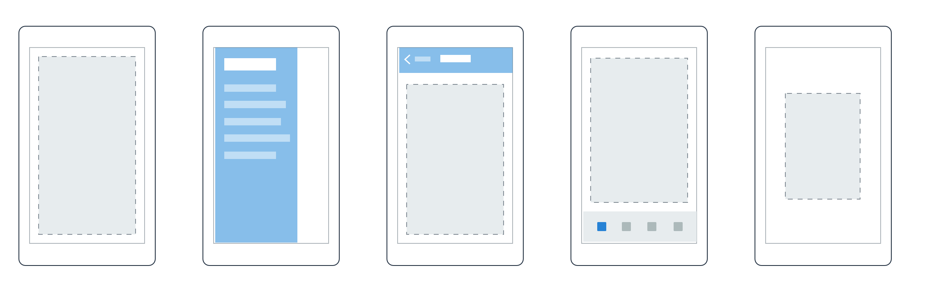

Pages
Content
MasterDetail
Navigation
Tabbed
Carousel
Notes:
First you have a set of pages for each screen of your application
There are things like Content, and MasterDetail which gives you a nice flyout
With a tabbed view you get the correct look on each platform
iOS on bottom, Android on top, and on WP you have a Pivot control

Slide 41
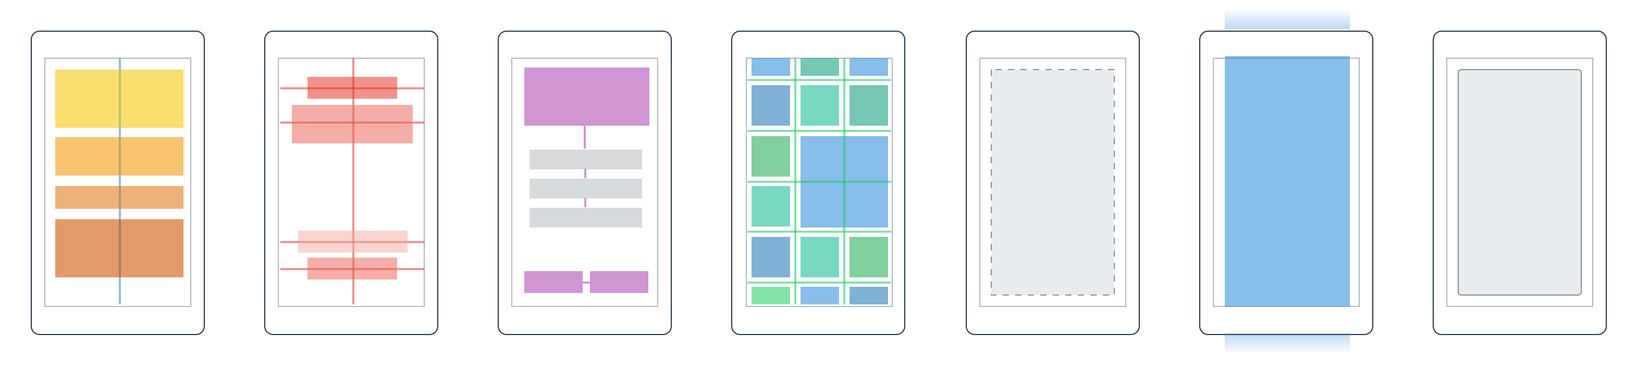
Layouts
Stack
Absolute
Relative
Grid
Content
View
ScrollView
Frame
Notes:
Inside of a page are layouts
A lot of options from something simple like a stack panel to complex and powerful grids

Slide 42
Controls
Activity
Indicator
BoxView
Button
DatePicker
Editor
Entry
Image
Label
ListView
Map
OpenGLView
Picker
ProgressBar
SearchBar
Slider
Stepper
TableView
TimePicker
WebView
EntryCell
ImageCell
SwitchCell
TextCell
ViewCell
Notes:
You have more than 40 controls, layouts, and pages to mix and match from.
These are all of the controls you have out of the box, you can of course create your own.
What is unique is you get the native control and have access to it.
Consider an Entry Field
On iOS it is mapped to UITextField
Android it is EditText
Windows Phoneit is a TextBox

Slide 43
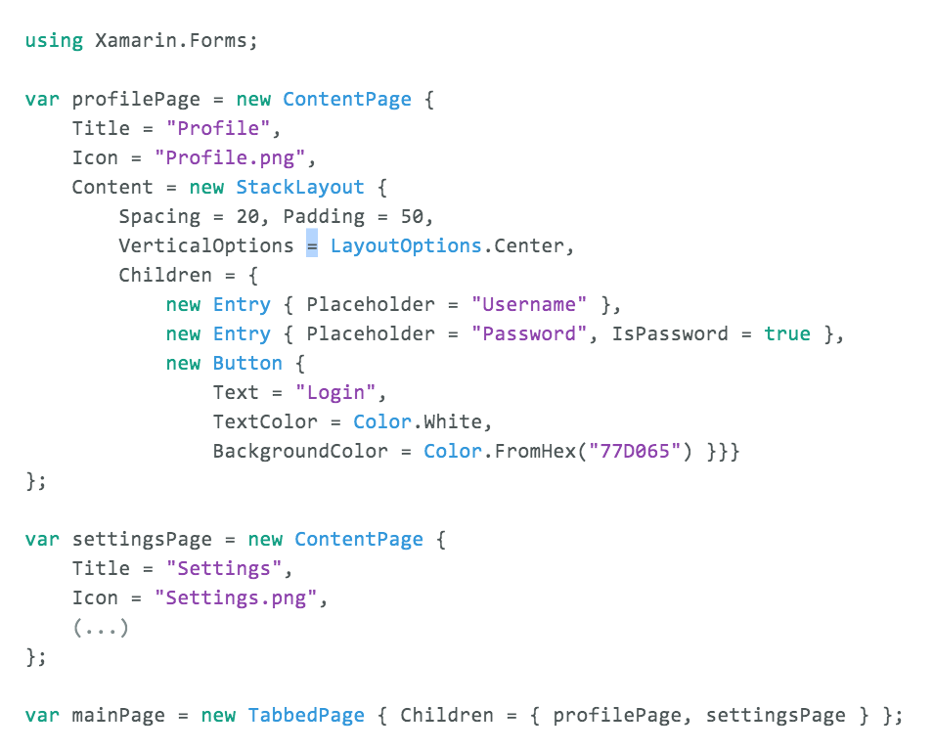
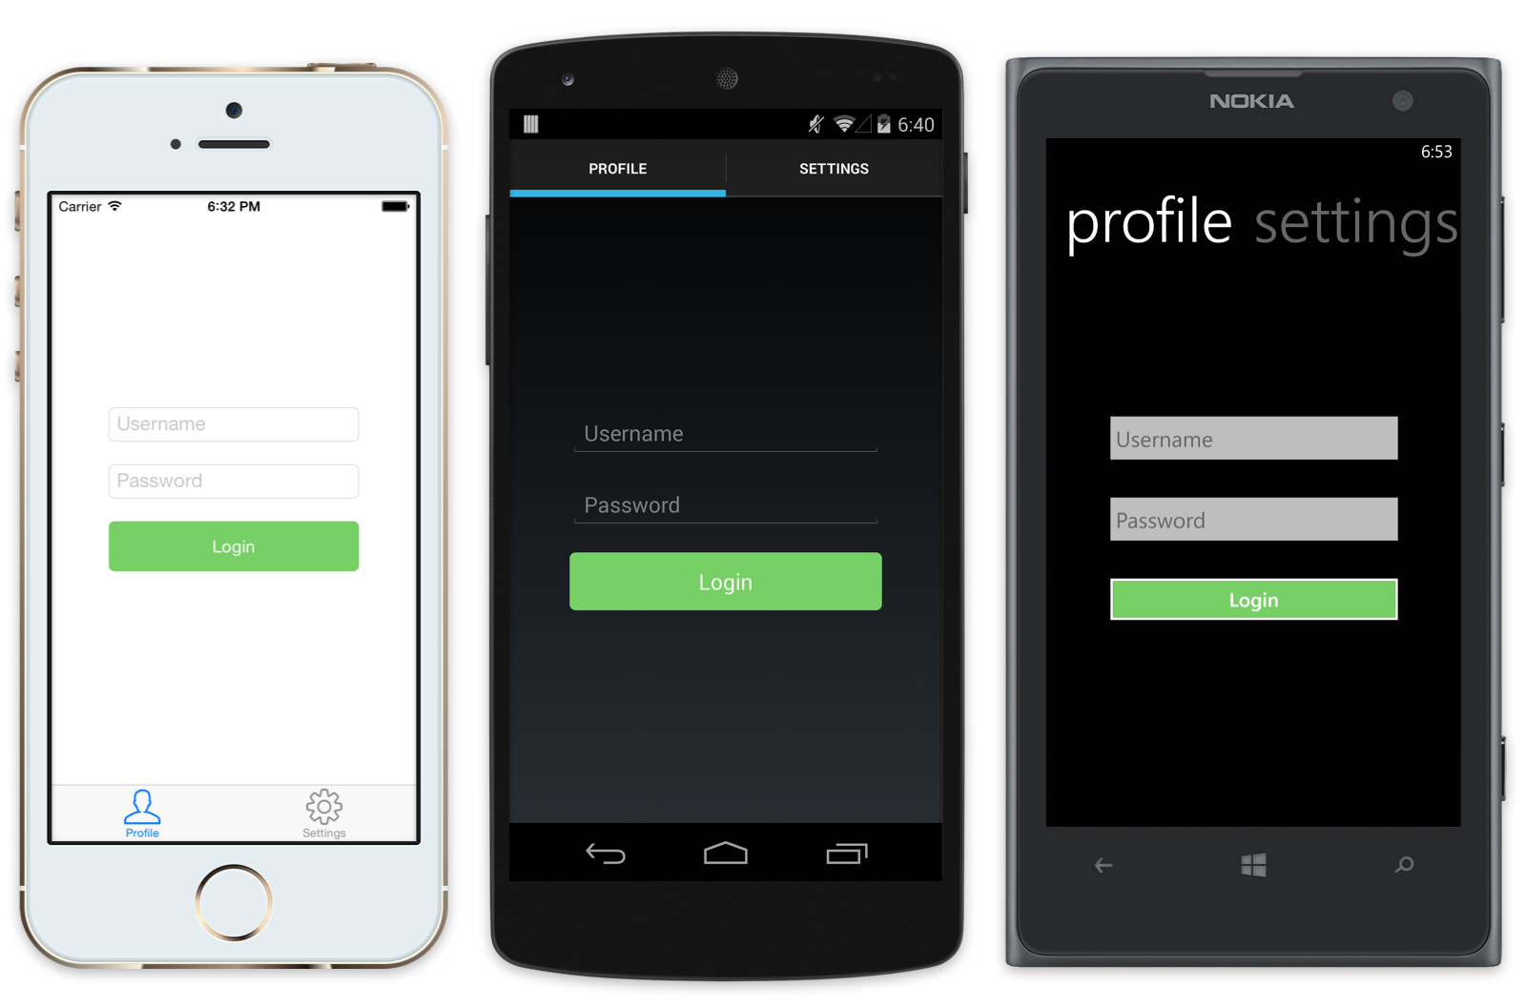
Exemple Xamarin.Forms
À l’exécution, les pages et contrôles Xamarin.Forms sont transformés en composants natifs.
Utilisez une seule API pour générer une interface native pour chaque plateforme
Notes:
Here is an example of Xamarin.Forms in action using C# in the code behind to create a login screen. You can see how each is rendered with the native controls on iOS, Android, and Windows Phone.

Slide 44
Démo
#OrleansTechTalks
Notes:
Demo time if so desired

Slide 45


Testez vos applications sur des milliers de devices dans le cloud

Slide 46


Monitorez votre application en temps réel. Récupérez les crashs et les exceptions détaillées de votre application suite à son utilisation par de vrais utilisateurs.

Slide 47


> Get Started Today: xamarin.com/download
> github.com/Julien-Mialon > blog.julienmialon.com

